Slide 1
RECOMBINANT:
An Active, Composable, and Heterogeneous I/O
Platform for Diverse
Artificial Intelligence (AI) Applications
Luke Logan
llogan@hawk.iit.edu

Slide 2
What is Artificial Intelligence (AI)?
Artificial Intelligence (AI)
An umbrella term representing a range of techniques that allow machines to mimic or exceed human intelligence
AI is applied in several domains to drive exploration
  Clustering for fraud detection in finance
  Large Language Models (LLMs) for acting as chatbots and coding agents
Machine Learning (ML)
Scientific
Simulation
Deep
Learning (DL)
Forests
Regression
Computer Vision
Nat. Lang. Processing
Large Language Models
Business /
Finance
Clustering

Slide 3
AI Apps are Very Data-Intensive
Sensors
Simulation
In the exascale AI era, data size has increased dramatically
Internet
Telescopes
Medical Imaging
Storage
Data Ingestion
(download data, ensure data quality)
2. Requires analysis of massive datasets
AI Training
(e.g., learn how to detect fraud)
3. Inference models are large and straining GPU and main memory limits
(llama 405-B is nearly 1TB)
AI Inference
(e.g., detect if each transaction is fraud)
4. Must gather context, which can be data-intensive
(e.g., scan a database)

Slide 4
AI Apps are Very Data-Intensive
But storage is many times slower than compute and often the bottleneck! [1]
Sensors
Simulation
In the exascale AI era, data size has increased dramatically
Internet
Telescopes
Medical Imaging
Storage
Data Ingestion
(download data, ensure data quality)
2. Requires analysis of massive datasets
AI Training
(e.g., learn how to detect fraud)
3. Inference models are large and straining GPU and main memory limits
(llama 405-B is nearly 1TB)
AI Inference
(e.g., detect if each transaction is fraud)
4. Must gather context, which can be data-intensive
(e.g., scan a database)
[1] Isakov, Mihailo, et al. "HPC I/O throughput bottleneck analysis with explainable local models." SC20: International Conference for High Performance Computing, Networking, Storage and Analysis. IEEE, 2020.

Slide 5
AI Apps are Very Data-Intensive
But storage is many times slower than compute and often the bottleneck! [1]
Sensors
Simulation
Internet
Telescopes
Medical Imaging
Storage
Data Ingestion
(download data, ensure data quality)
AI apps have diverse requirements that no single I/O stack fully addresses.
This leads to conflict and inefficiency.
AI Training
(e.g., learn how to detect fraud)
AI Inference
(e.g., detect if each transaction is fraud)
[1] Isakov, Mihailo, et al. "HPC I/O throughput bottleneck analysis with explainable local models." SC20: International Conference for High Performance Computing, Networking, Storage and Analysis. IEEE, 2020.

Slide 6
How do we improve I/O stacks to satisfy the requirements of diverse AI workloads?
What are the limitations of the existing approaches?

Slide 7
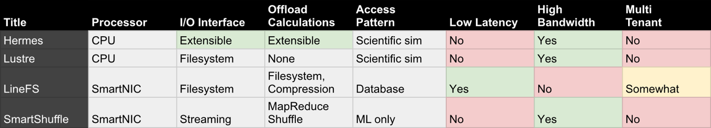
No Single I/O Stack Addresses All Requirements
E.g., Hermes designed for high-bandwidth scientific workloads, while LineFS designed for low-latency database workloads

Slide 8
Workload Diversity Causes Contention
Large I/O ops can stall small I/O ops
Fig 1
Fig 2
1MB
(1ms)
4KB
(15us)
One example of contention
4KB
(15us)
1MB
(1ms)
Storage
Fig 1: 4KB runs in 15us
Fig 2: 4KB runs in 1ms
68x slowdown
Multi-tenant environments exaggerate resource contention
Multi-Tenant: multiple apps (tenants) run simultaneously
This is the norm.
E.g., containers in Cloud, workflows in HPC

Slide 9

Research Question
How do we reduce resource contention across storage and processors caused by diverse data-intensive AI-driven apps running simultaneously?

Slide 10
Hardware Is Evolving To Address Diversity
CPU
Workload: General
Cores: 8 - 64
Freq: 2-5GHz
 | API | Bandwidth | Latency | $/GB
DRAM | Mem | 60GBps | 15ns | $3.30
PMEM | Mem | 6GBps | 100ns | $2.10
CXL SSD | Mem | 8GBps | 300ns | Est. $.08
NVMe SSD | Block / ZNS | 1.5GBps | 10us | $0.08
SATA SSD | Block | 550MBps | 70us | $0.04
HDD | Block | 150MBps | 15ms | $0.02
SmartNIC
Workload: Near-data processing (e.g., temp/sec)
Cores: 8 - 16
Freq: .8 - 1.5GHz
Compute.
Storage
Device (CSD)
Many storage and processing technologies have emerged to address different workload characteristics and requirements
GPU
Workload: Parallel instructions
Cores: >1000
Freq: 1.5 - 3 GHz
FPGA
Proc. In Mem. (PIM)
Modern machines integrate several technologies at once

Slide 11
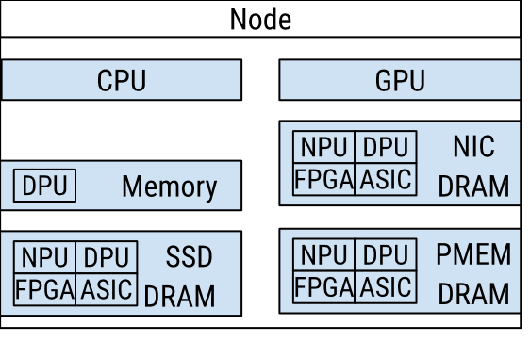
The Complexity of Modern Machines
However, using them is a complex task typically left to the user!
Where do you place data?
Where do you place computations?
So many options!
Too many choices results in either:
Suboptimal manual solutions
** Simply lack of use **
E.g., Many DOE labs employ NVMes that are unused by scientists

Slide 12

Research Question
How do we mask the growing diversification of processing and storage hardware to improve resource utilization for AI applications?

Slide 13



I/O Stacks Are Being Made to Leverage HW
Three examples:
LineFS
SmartShuffle
Hermes
Offload filesystem code from CPU to SmartNIC to reduce contention with app threads
Offload in-transit ML data ops to SmartNIC for similar reasons
Masks multiple tiers of storage for scientific programs

Slide 14
I/O Stacks Are Being Made to Leverage HW
Three examples:
LineFS
SmartShuffle
Hermes
Offload filesystem code from CPU to SmartNIC to reduce contention with app threads
Offload in-transit ML data ops to SmartNIC for similar reasons
Masks multiple tiers of storage for scientific programs
However, these have many limitations regarding their ability to handle diverse AI workloads on diverse hardware!

Slide 15


Limitations of Modern I/O Stacks for AI
Assume a particular machine architecture
Come with a rigid set of tightly coupled features that do not address all AI I/O needs
Cannot be extended dynamically after deployment to address changing AI behaviors and hardware
May simply not function across machines
(e.g., LineFS needs SmartNIC)
Limited set of policies that can't always be extended
(e.g., LineFS doesn't support data operators)
Upgrading code is aggressive and requires system reboot, shutting down all running apps.
Won't include all hardware on the machine
(e.g., Hermes can't use CSD)
For this reason, I/O code is almost never updated after deployment

Slide 16
Limitations of Modern I/O Stacks for AI
Assume a particular machine architecture
Come with a rigid set of tightly coupled features that do not address all AI I/O needs
Cannot be extended dynamically after deployment to address changing AI behaviors and hardware
May simply not function across machines
(e.g., LineFS needs SmartNIC)
Limited set of policies that can't always be extended
(e.g., LineFS doesn't support data operators)
Upgrading code is aggressive and requires system reboot, shutting down all running apps.
Won't include all hardware on the machine
(e.g., Hermes can't use CSD)
For this reason, I/O code is almost never updated after deployment

Slide 17
Limitations of Modern I/O Stacks for AI
Assume a particular machine architecture
Come with a rigid set of tightly coupled features that do not address all AI I/O needs
Cannot be extended dynamically after deployment to address changing AI behaviors and hardware
May simply not function across machines
(e.g., LineFS needs SmartNIC)
Limited set of policies that can't always be extended
(e.g., LineFS doesn't support data operators)
Upgrading code is aggressive and requires system reboot, shutting down all running apps.
Won't include all hardware on the machine
(e.g., Hermes can't use CSD)
For this reason, I/O code is almost never updated after deployment

Slide 18

Research Question
How do we improve I/O stack development methodologies to account for rapid evolution in hardware and AI I/O requirements?

Slide 19



Challenges to Solve these Questions
How do we improve I/O stack development methods?
How do we mask the growing diversification of hardware?
How do we mediate contention across diverse AI apps?
I/O stacks must switch to a modular design that can be easily extended and upgraded
New reactive algorithms must be created to automatically match I/O and computations to hardware
New scheduling policies must be made for understanding diverse, multi-tenant AI and hardware characteristics

Slide 20
Our Solution: Recombinant
A comprehensive I/O platform for addressing the characteristics of AI-driven apps in heterogeneous computing environments, with support for future extension to account for the rapidly evolving nature of AI and hardware

Slide 21
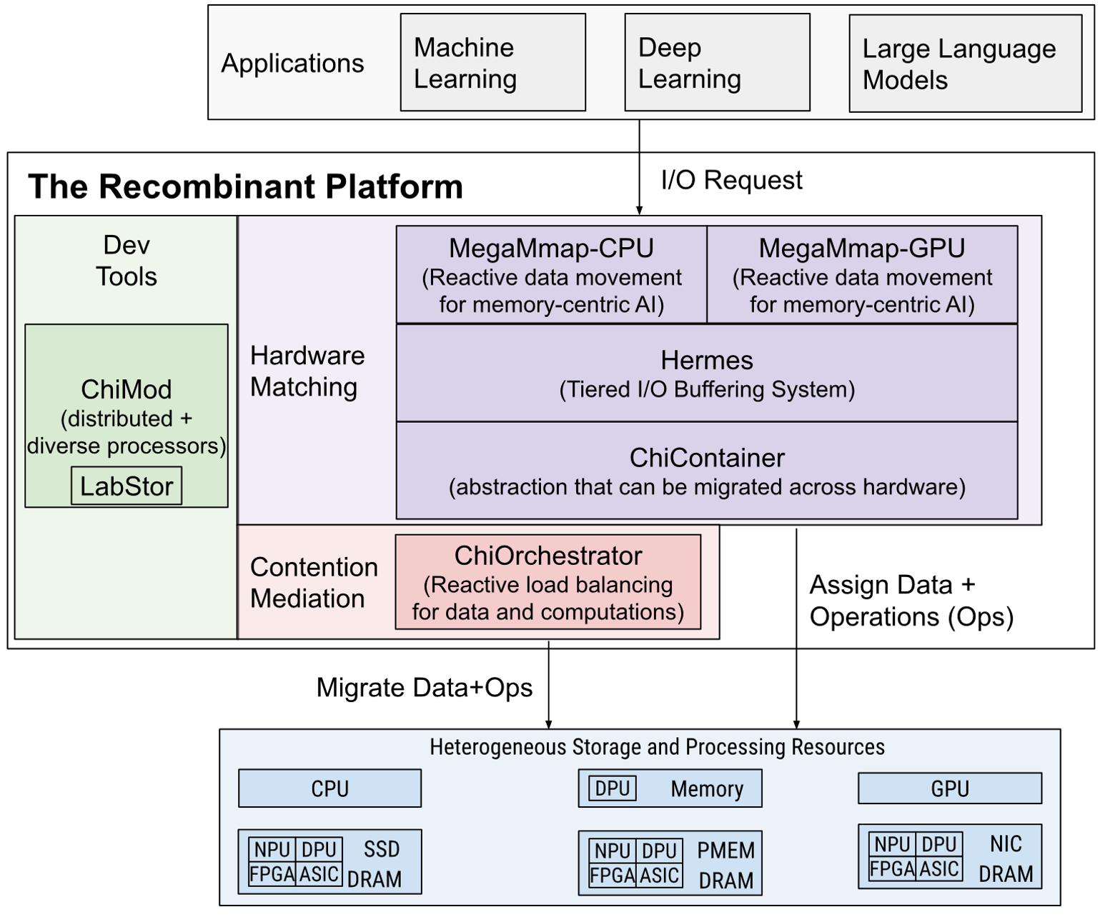
Recombinant Design
Three layers:
  Dev tools
  Hardware matching
  Contention mediation

Slide 22
Development Tools Layer
Development tools switch I/O stacks to a modular design
Abstractions to develop policies in Hardware Matching and Contention Mediation layers

Slide 23
Hardware Matching Layer
Hardware Matching​ is where app I/O first gets assigned to hardware
Provides abstractions and policies to automatically assign data + ops to diverse resources

Slide 24
Contention Mediation Layer
Contention Mediation is invoked to respond to contention over time
Provides policies that react to dynamic, multi-tenant AI behavior by intelligently migrating data+ops to reduce resource contention

Slide 25
Explaining Recombinant
Demonstrate a system to improve the development pace of I/O stacks in the single-node, CPU-only case
Enhance this system to consider the general case of I/O stacks in distributed, heterogeneous machines
Leverage this system to provide AI-specific I/O stacks

Slide 26
LabStor: A Modular & Extensible System for Building Single-Node I/O Stacks

Slide 27
LabStor: A Modular & Extensible System for Building Single-Node I/O Stacks
Come with a rigid set of tightly coupled features that do not address all AI I/O needs
Cannot be extended dynamically after deployment to address changing AI behaviors and hardware
I/O stacks must switch to a modular design
Novel code development toolkit to build custom I/O features
Provides algorithms to upgrade and swap features dynamically in milliseconds
Customized I/O paths are up to 60% faster than tightly-coupled counterparts

Slide 28
Chimaera: A System for Composing Distributed Heterogeneous I/O Stacks

Slide 29
Chimaera: A System for Composing Distributed Heterogeneous I/O Stacks
Assume a particular machine architecture
I/O stacks must switch to a modular design
Must automatically match I/O and computations to hardware
Scheduling algos must understand diverse AI and hardware
ChiMods: Evolves LabStor's code kit to be distributed and support diverse processing hardware
ChiContainers: An abstraction that enables computations and data to be migrated across processors and storage
(e.g., migrate compress + data to new machine if overloaded)
ChiOrchestrator: Dynamically migrates computations and data depending on diverse AI behaviors and hardware characteristics
Up to 46% faster than existing specialized I/O stacks
Chimaera is used in several funded NSF & DOE projects as well as educational activities

Slide 30
Extending Recombinant to AI Workloads

Slide 31

Extending Recombinant to AI Workloads
Must automatically match I/O to hardware
MegaMmap
Eternia
Provides the infrastructure to mask multiple tiers of storage through extensible data movement policies
Tailors Hermes to leverage AI memory access patterns to match data to heterogeneous storage
Leverages GPU access patterns to match memory access patterns to heterogeneous storage
Can reduce memory use by 2.6x without sacrificing performance
Can reduce memory use by 4x without sacrificing performance

Slide 32

LabStor: A Modular & Extensible System for Building Single-Node I/O Stacks

Slide 33




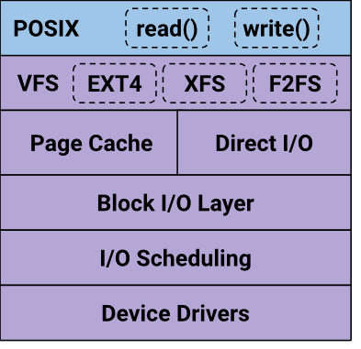
Motivation
Distributed I/O stacks rely on single-node kernel-level I/O stacks
However, both AI apps and storage hardware are evolving rapidly

Slide 34
Motivation
Distributed I/O stacks rely on single-node kernel-level I/O stacks
However, both AI apps and storage hardware are evolving rapidly
Node-local I/O stacks are not adapting rapidly enough!

Slide 35
Developing Kernel I/O Stacks is Difficult
POSIX
read()
write()
Tightly coupled with a rigid set of features. Cannot be reused across I/O stacks. Development complexity
VFS
F2FS
split
Access Ctrl
OS I/O code requires an aggressive reboot that shuts down all apps
Lowers adoption rate
compress
encrypt
block alloc
compact
Direct I/O
Page Cache
Not all policies are extensible and agnostic to AI behavior Performance loss
Block I/O Layer
I/O Scheduling
Device Drivers

Slide 36
The LabStor System
Come with a rigid set of tightly coupled features that do not address all AI I/O needs
Cannot be extended dynamically after deployment to address changing AI behaviors and hardware
I/O stacks must switch to a modular design
LabMod
LabStack
LabStor Runtime
A single-purpose code object representing an I/O feature
(e.g., FS, compress)
Combination of compatible LabMods into a specialized I/O stack
The main execution engine and provides protocols for upgrading code

Slide 37
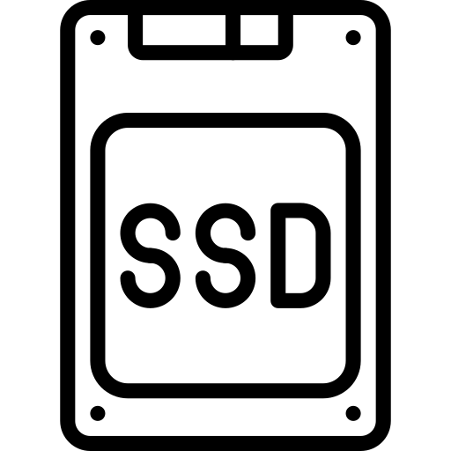
The Benefit of Single Responsibility
Linux Kernel
LabStor
Runtime
BTRFS
F2FS
JFFS2
Btrfs
Compress1
Compress2
Compress3
Compress
F2FS
LRU
Metadata
Metadata
Metadata
JFS
Kernel LOC | LabStor LOC
3756 | 327
LabMods provide the event handlers and callbacks needed to build single-purpose I/O features (e.g., device drivers, compression)
  E.g., kernel can't share compression code across filesystems – but LabStor can
10x less code needs to be written
Less debugging and implementation effort!

Slide 38
Composing LabMods into to LabStacks
LabStack: A user-defined combination of LabMods into an I/O system
Lab-All
Lab-Min
Lab-D
Client
Client
Client
Inter-Process Comm (IPC)
IPC
LabKVS
Permissions
LRU
LabKVS
LabKVS
NoOp
LRU
LRU
Drivers
NoOp
NoOp
Drivers
Drivers
A Cloud machine needing security across users
A machine where resources are dedicated to users (e.g., HPC)

Slide 39
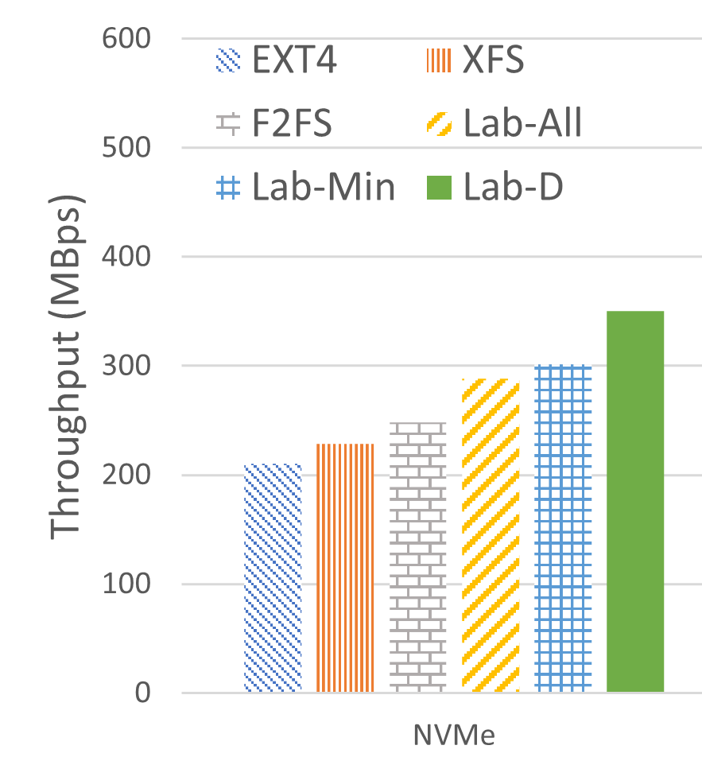
The Importance of Modularity and Customization
Demonstrate the impact of modular single-node I/O stacks on a distributed I/O system -- Labios
Vary the I/O stacks between kernel filesystems and LabKVS
We see that Lab-D is 18% faster than Lab-Min
  It has fewer modules
We see that Lab-D is 60% faster than kernel filesystems
  Labios doesn't have to translate a key-value store into a file

Slide 40
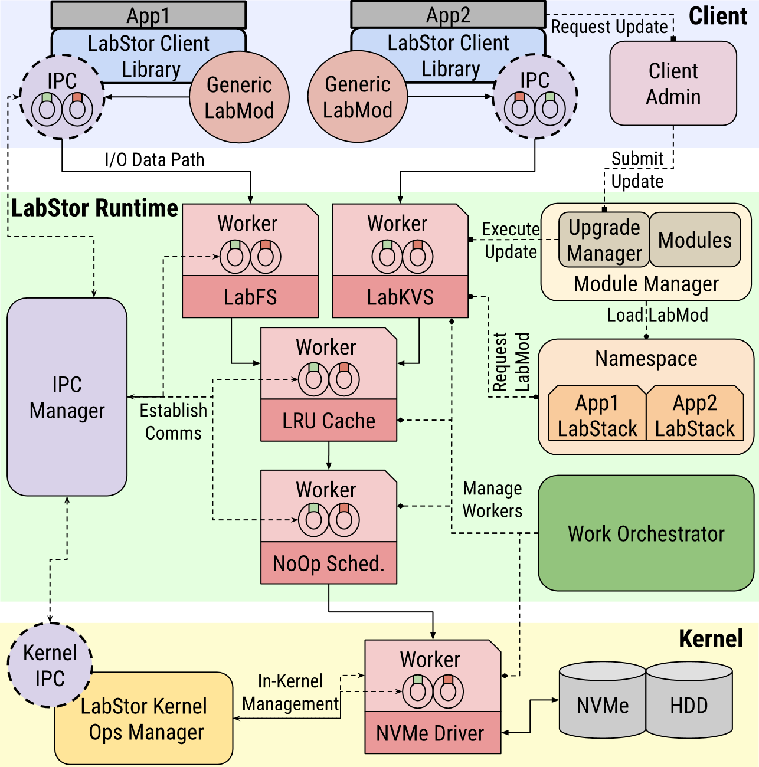
The Ability to Upgrade
The modularity of LabMods enables live code upgrade
LabMods can be paused. No need to reboot to ensure apps aren't using the code while being upgraded
It takes only 15ms to upgrade a LabMod, whereas a system reboot can be minutes and must shut down all programs

Slide 41
I/O Stacks can be Changed Dynamically
Using upgrades, people or AI apps can dynamically update I/O stacks
  E.g., swapping a different caching algorithm to better address an AI's behavior
Lab-All
AI App
Inter-Process Comm (IPC)
Permissions
LabKVS
SmartCache
LRU
NoOp
Drivers

Slide 42
Summary
Come with a rigid set of tightly coupled features that do not address all AI I/O needs
Cannot be extended dynamically after deployment to address changing AI behaviors and hardware
I/O stacks must switch to a modular design
Novel code development toolkit to build custom I/O features
Provides algorithms to upgrade and swap features dynamically in milliseconds
Customized I/O paths are up to 60% faster than tightly-coupled counterparts

Slide 43
Chimaera: A System for Composing Distributed, Heterogeneous I/O Stacks

Slide 44
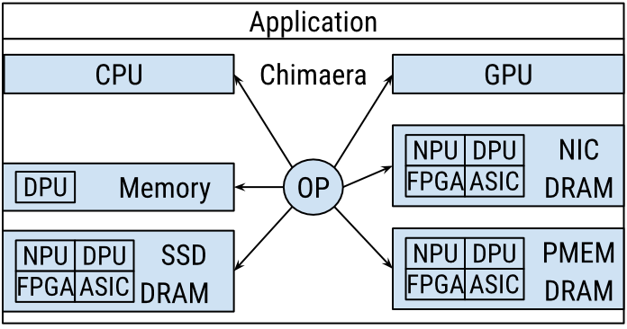
Building Upon the Success of LabStor (1)
LabStor focuses on development velocity in single-node cases over CPUs
However, distributed I/O stacks suffer from the same issues as single-node cases
Furthermore, processing hardware is also heterogeneous, not just storage

Slide 45
Building Upon the Success of LabStor (2)
This work extends LabStor to be distributed and include heterogeneity in processor resources

Slide 46
Contributions
Assume a particular machine architecture
I/O stacks must switch to a modular design
Must automatically match I/O and computations to hardware
Scheduling algos must understand diverse AI and hardware
ChiMod
Improves development velocity by allowing single-purpose I/O features (e.g., FS, compress) to be developed and deployed across heterogeneous processors
ChiContainer
An abstraction that enables computations and data to be migrated across processors and storage to improve resource utilization and performance
ChiOrchestrator
Improves resource utilization and reduces contention by automatically scheduling ChiContainers across processors through active monitoring

Slide 47
Design

Slide 48
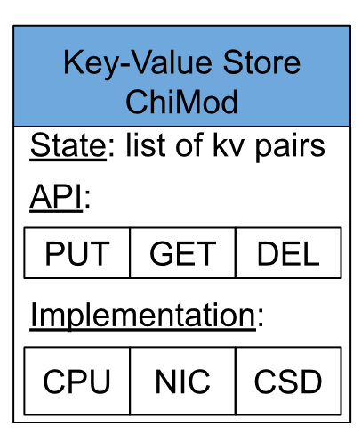
Enhancing the Modular Design
ChiMod: a code object for a single-purpose I/O feature.
Implements ops to perform in the context of a state
ChiMods can have many implementations
(Allows their work to be migrated across diverse processors)​

Slide 49
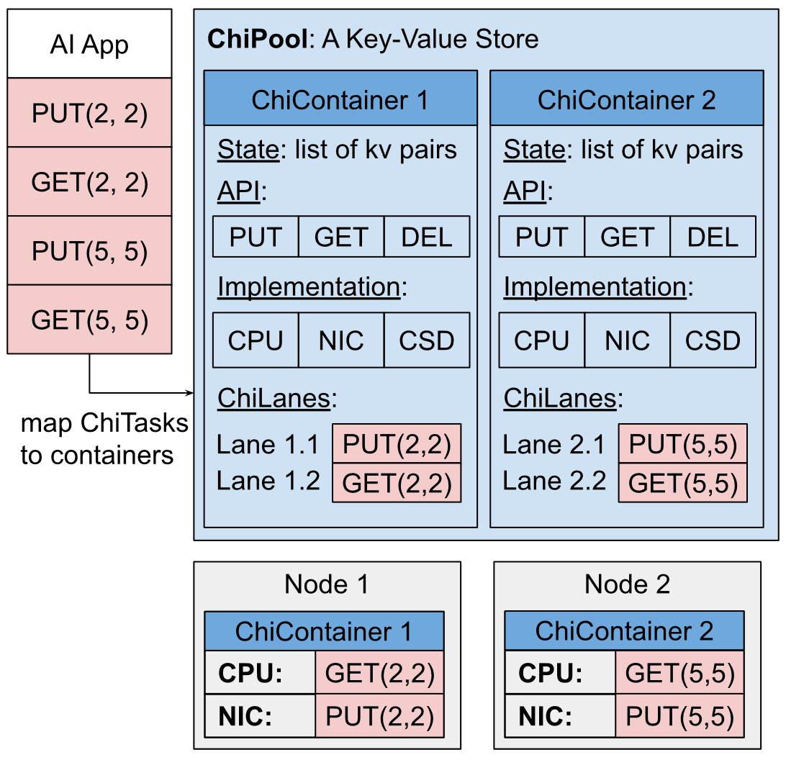
Abstracting Distributed, Heterogeneous Hardware
When instantiated, a ChiMod becomes a ChiPool: a distributed I/O system
ChiPools have a set of ChiContainers: a subset of the global state and its API
  Can be migrated across nodes
Apps communicate with ChiContainers using ChiTasks (they store API params)
ChiContainers are divided into ChiLanes: virtual execution units for ChiTasks
  Analogous to OS threads, but can be migrated across processors within a node

Slide 50
Abstracting Distributed, Heterogeneous Hardware
When instantiated, a ChiMod becomes a ChiPool: a distributed I/O system
ChiPools have a set of ChiContainers: a subset of the global state and its API
  Can be migrated across nodes
Apps communicate with ChiContainers using ChiTasks (they store API params)
ChiContainers are divided into ChiLanes: virtual execution units for ChiTasks
  Analogous to OS threads, but can be migrated across processors within a node

Slide 51
Abstracting Distributed, Heterogeneous Hardware
When instantiated, a ChiMod becomes a ChiPool: a distributed I/O system
ChiPools have a set of ChiContainers: a subset of the global state and its API
  Can be migrated across nodes
Apps communicate with ChiContainers using ChiTasks (they store API params)
ChiContainers are divided into ChiLanes: virtual execution units for ChiTasks
  Analogous to OS threads, but can be migrated across processors within a node

Slide 52
Abstracting Distributed, Heterogeneous Hardware
When instantiated, a ChiMod becomes a ChiPool: a distributed I/O system
ChiPools have a set of ChiContainers: a subset of the global state and its API
  Can be migrated across nodes
Apps communicate with ChiContainers using ChiTasks (they store API params)
ChiContainers are divided into ChiLanes: virtual execution units for ChiTasks
  Analogous to OS threads, but can be migrated across processors within a node

Slide 53
Composing Complex I/O Stacks
ChiPools can be stacked together to form complex, heterogeneous I/O stacks
These pools are automatically scheduled across heterogeneous processors
Pool 1: Compression
Pool 2: Encrypt
Pool 3: Key-Value Store
Pool 4: Device Drivers

Slide 54
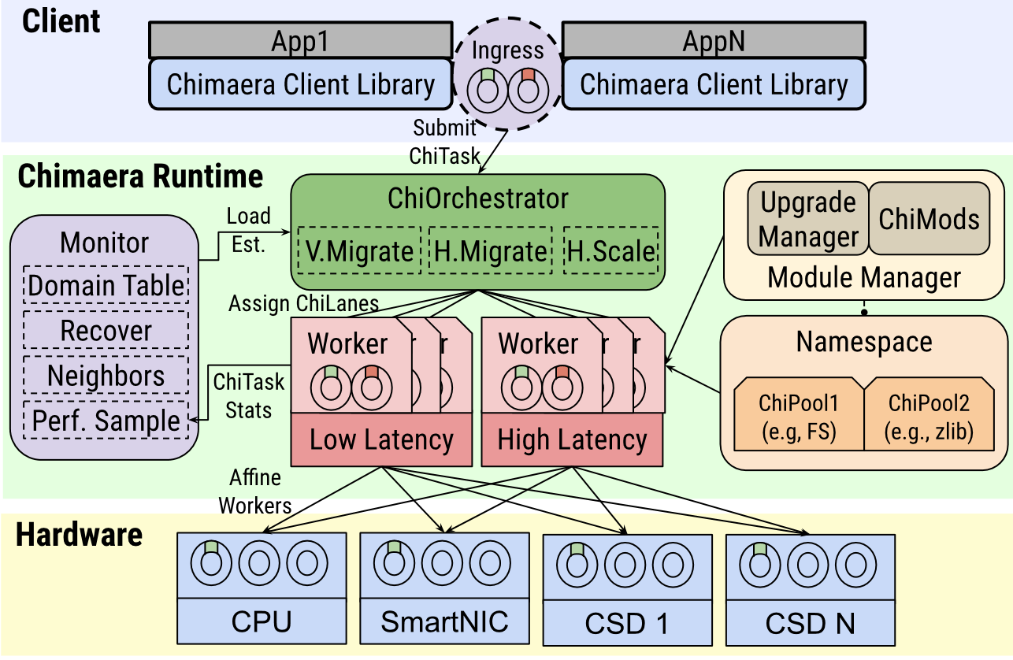
Orchestrating ChiContainers
Runtime dynamically monitors the computational and I/O behavior of ChiContainers
Used for algorithms to migrate ChiLanes and ChiContainers in the ChiOrchestrator
  Vertical migration
  Horizontal migration

Slide 55
Vertical Migration
When ChiLanes are migrated across processors within a node
Only computations are moved, data remains in place
  How fast is the ChiLane on processor p?
  How energy-efficient is processor p?
ChiTasks can tradeoff speed for energy
  E.g., a background task may accept a 40% slowdown, while a critical task accepts 5%
Node
CPU
SmartNIC
CSD

Slide 56
Horizontal Migration
When ChiContainers are migrated across nodes or processors
Similar to vertical, but the main difference is that ChiContainers move both the data and computations
The cost of data movement is also factored when migrating
Node 1
Node 2
CPU
CPU
SmartNIC
SmartNIC
CSD
CSD

Slide 57
Evaluation

Slide 58
Evaluation Objectives
Chimaera can dynamically learn performance of ChiMods and leverage that to make good scheduling decisions
Allowing I/O stacks to be dynamically offloaded to accelerators yields performance and energy benefits
Intelligent scheduling can mediate contention, resulting in better overall multi-tenant performance and utilization

Slide 59
Testbed Resources
CPU
Cores: 12
Freq: 2.2GHz
SmartNIC
Cores: 8
Freq: 1GHz
*Emulated
CSD
Cores: 4
Freq: 1GHz
*Emulated

Slide 60
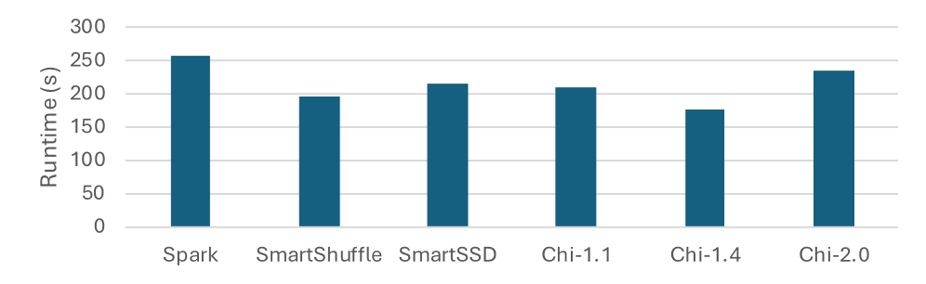
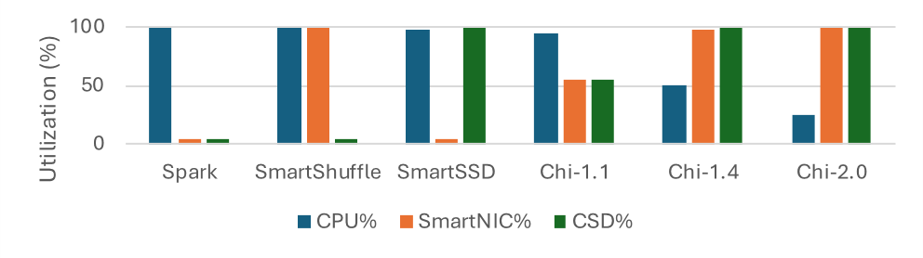
The Benefits of Leveraging All Hardware
Compare against existing work for offloading an AI credit fraud detection algorithm to accelerators
Measure runtime and resource utilization
Chi-1.4 30% faster than SmartShuffle
  SmartShuffle does not use CSD
Chi-1.4 46% faster than Spark
  Spark uses neither CSD nor SmartNIC

Slide 61
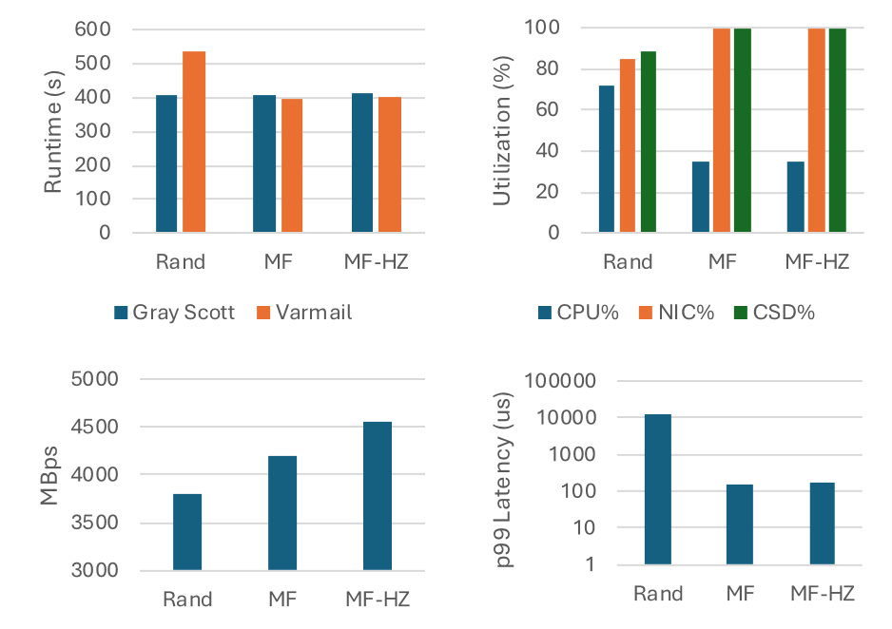
Reducing Cross-Application Contention
We run two workloads simultaneously
  Gray-Scott (high-bandwidth)
  Varmail (low-latency)
Compares:
  Random migration
  Vertical-only (MF)
  Vertical+horizontal (MF-HZ)

Slide 62
Reducing Cross-Application Contention
For Varmail, MF & MF-HZ give:
  35% faster runtime than rand
  80x lower p99 latency
  Rand places large I/O tasks on the same workers as small ones, causing head-of-line blocking
For Gray-Scott, MF-HZ gives:
  13% faster than Rand
  8% faster than MF
  MF-HZ migrates state to the CSD and SmartNIC to improve data locality
Gray Scott
Varmail

Slide 63
Reducing Cross-Application Contention
For Varmail, MF & MF-HZ give:
  35% faster runtime than rand
  80x lower p99 latency
  Rand places large I/O tasks on the same workers as small ones, causing head-of-line blocking
For Gray-Scott, MF-HZ gives:
  13% faster than Rand
  8% faster than MF
  MF-HZ migrates state to the CSD and SmartNIC to improve data locality
Gray Scott
Varmail

Slide 64
Summary

Slide 65
Summary
Assume a particular machine architecture
I/O stacks must switch to a modular design
Must automatically match I/O and computations to hardware
Scheduling algos must understand diverse AI and hardware
We showcase a modular design to build heterogeneous I/O features through ChiMods
We abstracted physical processing and storage resources through migrateable ChiContainers
We build policies to migrate I/O stack work across processors through the ChiOrchestrator
Up to 46% improvement to alternative I/O stacks by leveraging all available hardware
Up to 35% improvement in performance in multi-tenant cases

Slide 66
Extending Recombinant to AI Workloads

Slide 67
Extending Recombinant to AI Workloads
Chimaera provides the abstractions necessary to build complex, heterogeneous I/O systems
We now leverage Chimaera to build I/O systems that address the I/O behaviors of AI workloads

Slide 68
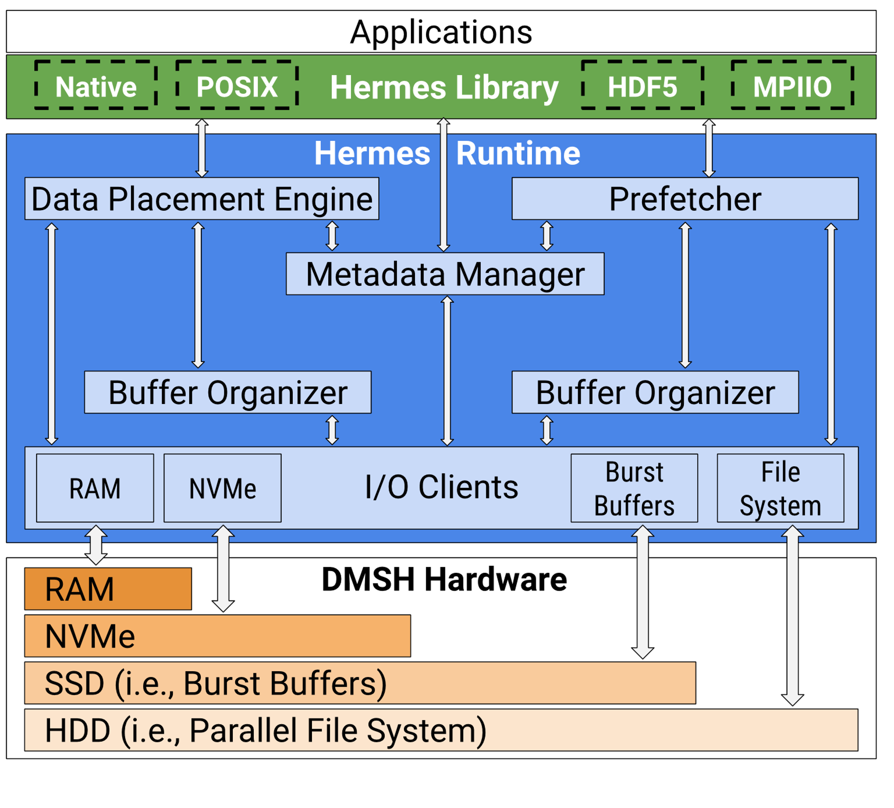
Hermes: A Distributed I/O Buffering Platform
Presents the distributed memory and storage hierarchy (DSMH) as one single system
Extensible data placement and organization policies to improve I/O concurrency and data location
However, it's current policies only support scientific workloads
We must extend Hermes to support diverse AI workloads

Slide 69
Memory-Centric, Data-Intensive AI Workloads
AI workloads are becoming increasingly data-intensive

Slide 70
Memory-Centric, Data-Intensive AI Workloads
AI workloads are becoming increasingly data-intensive
The data volume is increasing beyond what main memory can hold!

Slide 71


Two Main Solutions
Just buy more DRAM...
Out-of-core Programming

Slide 72

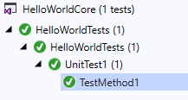


Just Buy More DRAM
Pros:
Cons:
Don't need to change applications
DRAM is very expensive
DRAM has a very high energy cost
 | Price | Capacity | $/GB
DRAM | $106 | 32GB | $3.30
PMEM | $275 | 128GB | $2.10
NVMe | $169 | 2TB | $0.08
SATA SSD | $175 | 4TB | $0.04
HDD | $369 | 18TB | $0.02

Slide 73




Out-Of-Core Programming
Use storage to offload memory pressure
Pros:
Cons:
Don't need to
spend money on hardware
More energy efficient
(less DRAM)
Development Complexity
Suboptimal, one-off, manual solutions

Slide 74
We want an effectively infinite memory to interact with massive datasets, but without having to purchase more DRAM!

Slide 75
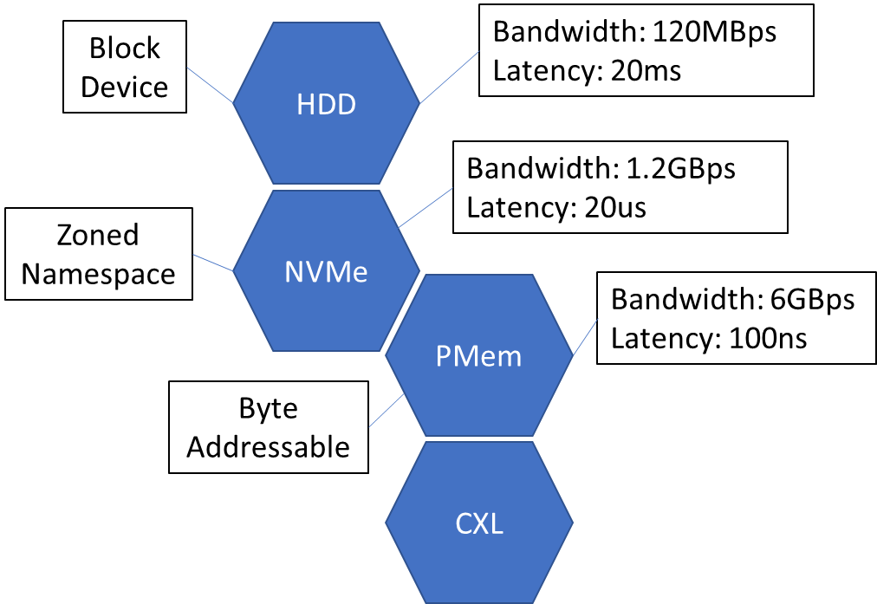
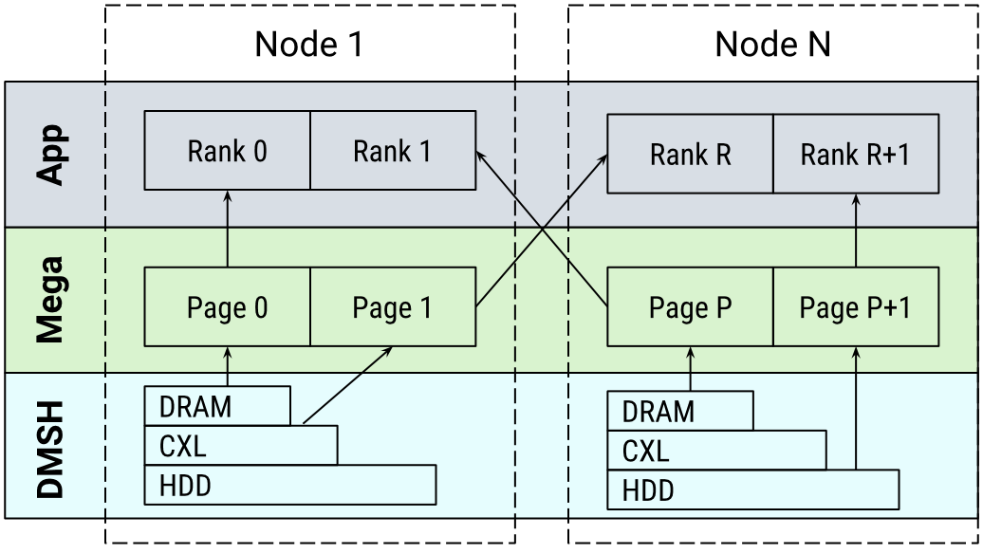
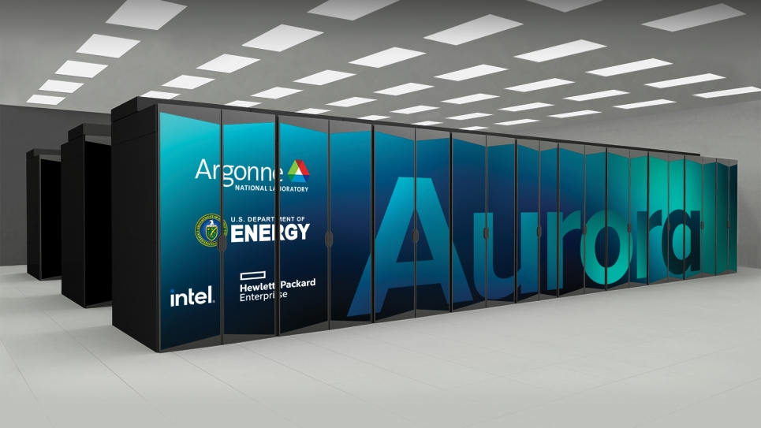

Blurring The Line Between Memory and Storage
Storage has emerged with similar performance to DRAM
We can combine DRAM and storage into a tiered distributed shared memory (DSM)

Slide 76
However, storage is at least 10x slower than DRAM. How can we mask this performance behind a memory abstraction?

Slide 77
Our Approach: MegaMmap
An intuitive DSM system that presents massive datasets as memory
Must automatically match I/O to hardware
Transactional Memory API
Memory Coherence Optimizations
Tiered data organization policies
AI apps propagate their access pattern intent to improve data movement performance
Leverages access pattern intent to ensure memory accesses are correct and speedy
Leverages access pattern intent to reduce I/O stalls caused by storage accesses

Slide 78
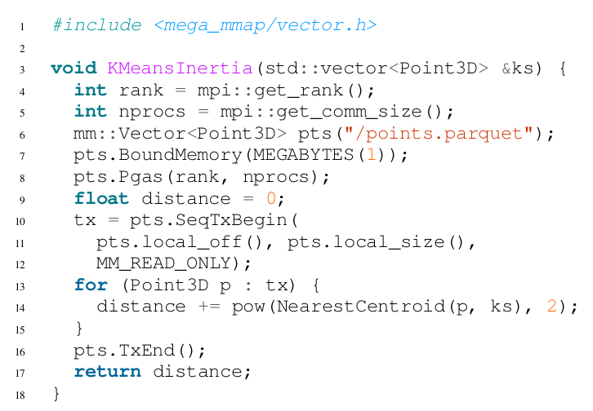
Presenting Datasets As Memory
Mass datasets in memory
Transactions mark the access pattern
Similar to C++ iterator

Slide 79
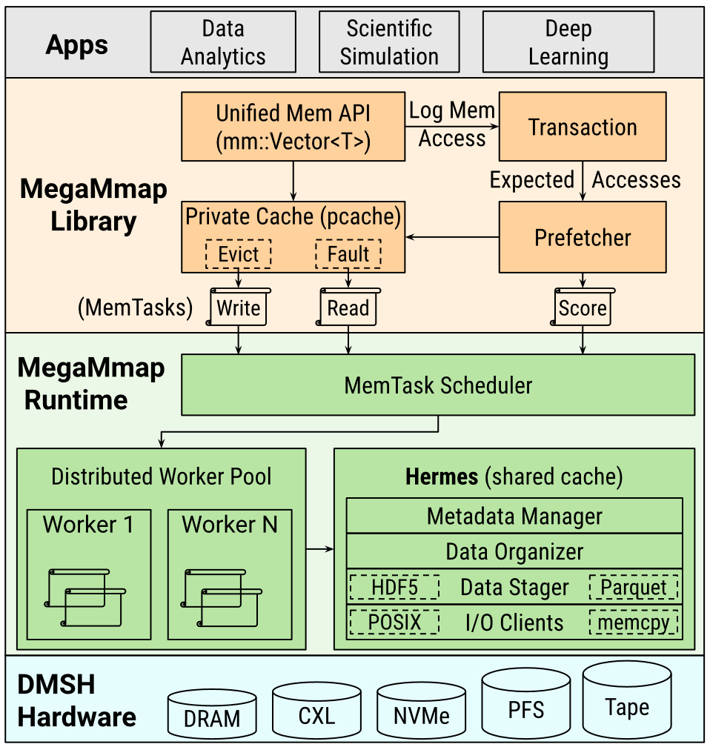
Actively Ensuring Persistence
Apps first store data in the private cache
Eventually moved to shared cache, which is implemented on top of Hermes
Runtime eventually persists data stored in the scache asynchronously
All scache data is flushed when the runtime shuts down

Slide 80
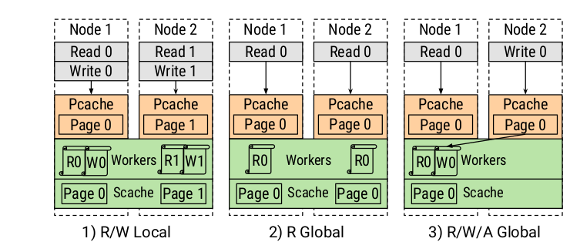
Efficient Memory Coherence
Leverages access pattern intent to relax coherence requirements
E.g., R Global (read-only) will never modify data, so there is no overhead to coherence

Slide 81
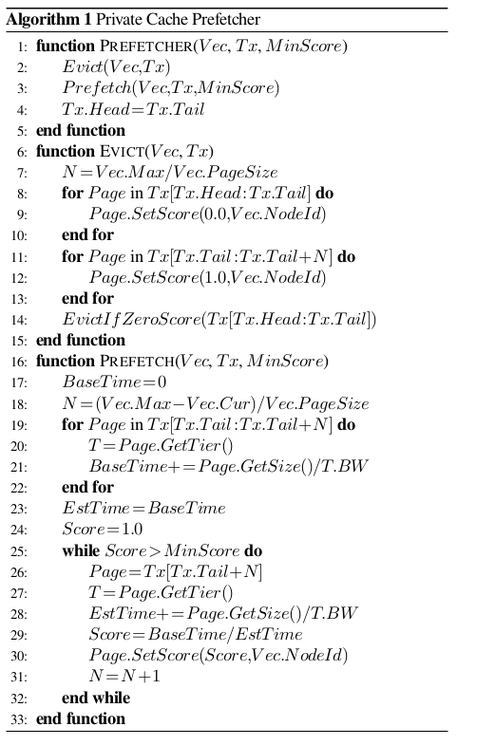
Masking I/O Stalls
The prefetcher asynchronously migrates data based on the access pattern described by transactions
Data soon to be accessed goes in higher performance devices
Colder data moves to slower storage

Slide 82
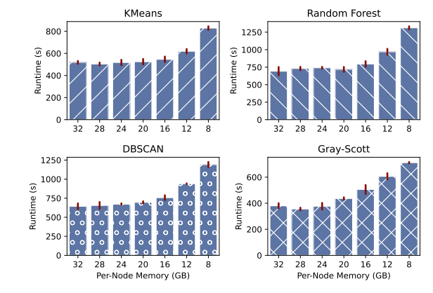
We can use less memory!
Lower the amount of DRAM in several AI workloads
  Each workload uses 32GB of DRAM per node
Pages spill to tiered storage when DRAM runs out
MegaMmap algorithms can use 2.6x less DRAM with minimal performance impacts due to workload-aware prefetching

Slide 83
Eternia: Extending MegaMmap to GPUs
Scientific and Machine Learning GPU workloads can also be highly data-intensive
Eternia expands MegaMmap to support the characteristics of distributed GPU workloads

Slide 84
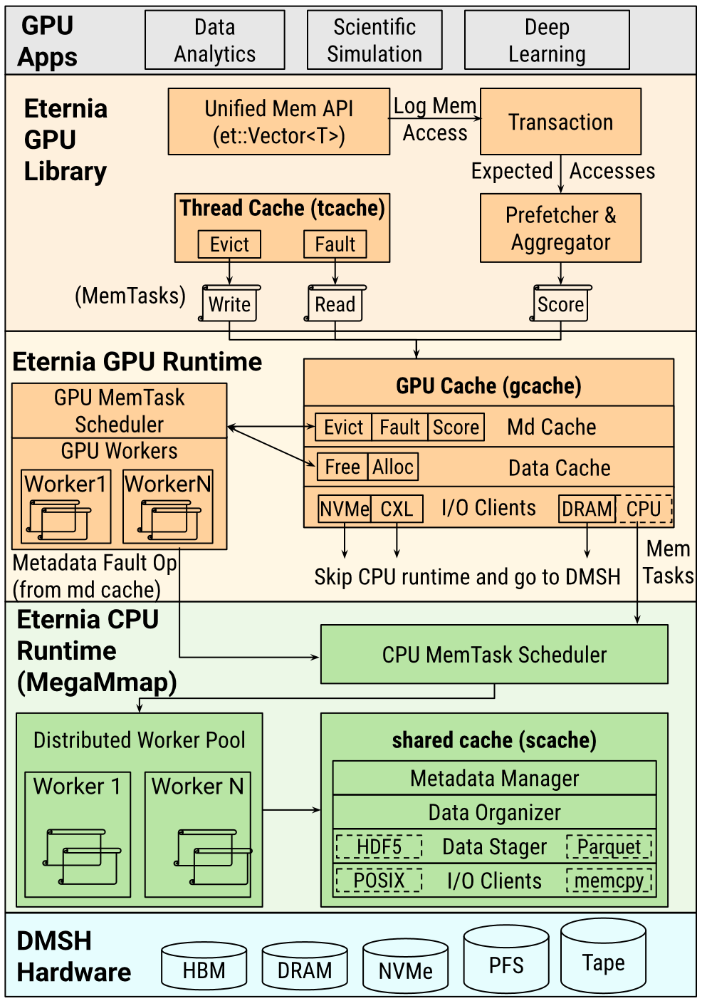
GPU Cache + Runtime
GPU library stores a small thread cache (tcache) per GPU thread
GPU runtime stores a larger GPU-wide cache (gcache) across kernels
When data is not in the tcache, it will attempt to copy from gcache
If not in gcache, must copy from storage
  Direct access to storage is used whenever possible
  Otherwise, data access is delegated to the CPU Runtime

Slide 85
Prefetching on GPU
GPU threads indicate pages to prefetch based on transaction (access pattern)
  Similar to MegaMmap
Page scores sent to GPU runtime
  Score ops aggregated per GPU warp (a group of 32 threads) to improve performance
Data with low score will be evicted from GPU and sent to CPU runtime
Data with high score will be prefetched into the GPU

Slide 86
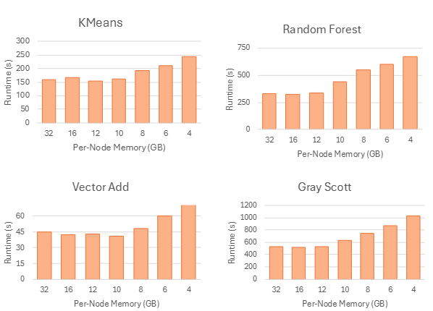
Reducing HBM Consumption
Lower HBM for various workloads
4 nodes, 1 GPU per node
Datasets 2x larger than memory
With effective data placement / prefetching, up to 4x less memory required to run by matching storage performance

Slide 87
Summary
Must automatically match I/O to hardware
MegaMmap
Eternia
Provides the infrastructure to mask multiple tiers of storage through extensible data movement policies
Tailors Hermes to leverage AI memory access patterns to match data to heterogeneous storage
Leverages GPU access patterns to match memory access patterns to heterogeneous storage
Can reduce memory use by 2.6x without sacrificing performance
Can reduce memory use by 4x without sacrificing performance

Slide 88
Overall Summary

Slide 89
Step 1: Building I/O Stacks in the Single-Node, Homogeneous Case
Come with a rigid set of tightly coupled features that do not address all AI I/O needs
Cannot be extended dynamically after deployment to address changing AI behaviors and hardware
I/O stacks must switch to a modular design
Novel code development toolkit to build custom I/O features
Provides algorithms to upgrade and swap features dynamically in milliseconds
Customized I/O paths are up to 60% faster than tightly-coupled counterparts

Slide 90
Step 2: Building I/O Stacks in the Distributed, Heterogeneous Case
Assume a particular machine architecture
I/O stacks must switch to a modular design
Must automatically match I/O and computations to hardware
Scheduling algos must understand diverse AI and hardware
We showcase a modular design to build heterogeneous I/O features through ChiMods
We abstracted physical processing and storage resources through migrateable ChiContainers
We build policies to migrate I/O stack work across processors through the ChiOrchestrator
Up to 46% improvement to alternative I/O stacks by leveraging all available hardware
Up to 35% improvement in performance in multi-tenant cases

Slide 91
Step 3: Building I/O Stacks Tailored to AI
Must automatically match I/O to hardware
MegaMmap
Eternia
Provides the infrastructure to mask multiple tiers of storage through extensible data movement policies
Tailors Hermes to leverage AI memory access patterns to match data to heterogeneous storage
Leverages GPU access patterns to match memory access patterns to heterogeneous storage
Can reduce memory use by 2.6x without sacrificing performance
Can reduce memory use by 4x without sacrificing performance

Slide 92
Overall Summary
How do we improve development methods to account for rapid evolution an AI apps and hardware?
How can we leverage the growing diversification of resources to ensure sustainability and speed of AI workloads?
How do we reduce resource contention caused by diverse data-intensive AI-driven apps running simultaneously?
Switching to a modular I/O stack design allows for optimized I/O paths to be rapidly made and easily maintained
Automatically matching I/O and computations to hardware allows improvements to both energy-efficiency and performance
Scheduling policies that factor dynamic and diverse AI app behavior and hardware improve performance and resource use
Through Recombinant's modular, automated, and hardware-aware design, we can achieve up to 4x reduced memory consumption while maintaining high performance

Slide 93
Other Accomplishments

Slide 94
Publications (1/2)
Two primary publications
  L. Logan, J. Cernuda, J. Lofstead, X.-H. Sun, and A. Kougkas. "LabStor: A Modular and Extensible Platform for Developing High-Performance, Customized I/O Stacks in Userspace." In Proceedings of the International Conference for High Performance Computing, Networking, Storage and Analysis (SC'22), Nov. 2022.
  Pages 309-323.
  Luke Logan, Anthony Kougkas, and Xian-He Sun. 2024. MegaMmap: Blurring the Boundary Between Memory and Storage for Data-Intensive Workloads. In Proceedings of the International Conference for High Performance Computing, Networking, Storage, and Analysis (SC '24). IEEE Press, Article 108, 1–18. https://doi.org/10.1109/SC41406.2024.00114

Slide 95
Publications (2/2)
Seven Co-Author Publications
  H. Devarajan, A. Kougkas, L. Logan and X. Sun, "HCompress: Hierarchical Data Compression for Multi-Tiered Storage Environments," 2020 IEEE International Parallel and Distributed Processing Symposium (IPDPS), New Orleans, LA, USA, 2020, pp. 557-566, doi: 10.1109/IPDPS47924.2020.00064.
  Cernuda, J., Logan, L., Gainaru, A., Klasky, S., Lofstead, J., Kougkas, A., & Sun, X.-H. (May 6-9 2024). Hades: A Context-Aware Active Storage Framework for Accelerating Large-Scale Data Analysis. The 24th IEEE/ACM International Symposium on Cluster, Cloud and Internet Computing, 577–586. doi:DOI 10.1109/CCGrid59990.2024.00070
  K. Bateman et al., "LuxIO: Intelligent Resource Provisioning and Auto-Configuration for Storage Services," 2022 IEEE 29th International Conference on High Performance Computing, Data, and Analytics (HiPC), Bengaluru, India, 2022, pp. 246-255, doi: 10.1109/HiPC56025.2022.00041. K. Bateman ., "LuxIO: Intelligent Resource Provisioning and Auto-Configuration for Storage Services," , Bengaluru, India, 2022, pp. 246-255, doi: 10.1109/HiPC56025.2022.00041.
  J. Cernuda, H. Devarajan, L. Logan, K. Bateman, N. Rajesh, J. Ye, A. Kougkas, X.-H. Sun, “HFlow: A Dynamic and Elastic Multi-Layered Data Forwarder”, The 2021 IEEE International Conference on Cluster Computing (CLUSTER'2021), September 7-10, 2021, Virtual Meeting, pp. 114-124, DOI: 10.1109/Cluster48925.2021.00064.
  Neeraj Rajesh, Hariharan Devarajan, Jaime Cernuda Garcia, Keith Bateman, Luke Logan, Jie Ye, Anthony Kougkas, and Xian-He Sun. 2020. Apollo: An ML-assisted Real-Time Storage Resource Observer. In Proceedings of the 30th International Symposium on High-Performance Parallel and Distributed Computing (HPDC '21). Association for Computing Machinery, New York, NY, USA, 147–159. DOI:https://doi.org/10.1145/3431379.3460640
  H. Devarajan, A. Kougkas, L. Logan and X. Sun, "HCompress: Hierarchical Data Compression for Multi-Tiered Storage Environments," 2020 IEEE International Parallel and Distributed Processing Symposium (IPDPS), New Orleans, LA, USA, 2020, pp. 557-566, doi: 10.1109/IPDPS47924.2020.00064.
  Keith Alex Bateman, Neeraj Rajesh, Jaime Cernuda, Luke Logan, Bogdan Nicolae, Franck Cappello, Xian-He Sun, and Anthony Kougkas. 2025. DTIO: Data Stack for AI-driven Workflows. In Proceedings of the 37th International Conference on Scalable Scientific Data Management (SSDBM '25). Association for Computing Machinery, New York, NY, USA, Article 4, 1–12. https://doi.org/10.1145/3733723.3733736

Slide 96
Educational Activities
Recombinant has been used by dozens of students in coursework and in relation to their thesis projects
Currently, we have students building I/O libraries for GPUs based on Recombinant
Another group of students is investigating how to integrate Recombinant with more GPU-centric scientific workflows

Slide 97
NSF Projects
Recombinant used in two funded NSF projects
  Hermes & IoWarp
Hermes is a distributed, tiered I/O buffering for scientific applications that was recently reimplemented using Recombinant
IoWarp is a distributed I/O platform that provides a natural-language interface for scientific data exploration, using Hermes as a backend
Currently working on using Recombinant to build data operators that enhance data quality for LLMs to understand data stored in filesystems

Slide 98
DOE Projects
Recombinant is used in active DOE projects: COEUS + DTIO
COEUS improves the performance of scientific workflows by allowing analysis to occur while data is produced
DTIO aims to unify diverse storage stacks and provide features such as resilience, fault tolerance, and task replay
One publication that uses Recombinant to provide data operators that transparently calculate data statistics for a specific program
PhD students and engineers are currently working on adding mathematical operators (e.g., integral) to Recombinant for more complex programs

Slide 99
Future Vision

Slide 100
Future Work
AI Agents are increasingly becoming the main consumers of data
However, I/O systems have traditionally been designed to support human interaction
In our recent grant IOWarp, we are working on leveraging Recombinant to improve the descriptions of data for AI Agents
  Transparent data tagging that includes information about the shape and meaning of data
  With this, AI Agents

Slide 101


Slide 102
Extra Slides

Slide 103
RECOMBINANT:
An Active, Composable, and Heterogeneous I/O
Platform for Diverse
AI Applications
Luke Logan
llogan@hawk.iit.edu

Slide 104

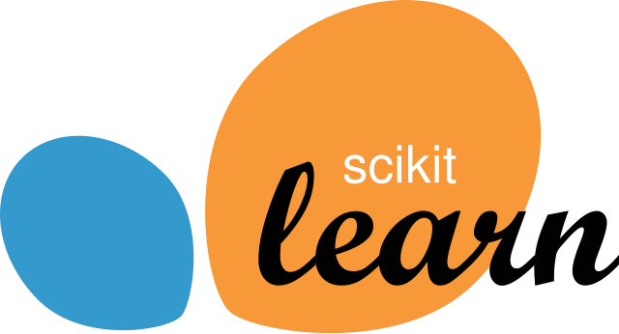

AI Drives Exploration Across Domains (1/4)
Several examples exist:
Classification algos are applied to fraud detection in finance
Clustering algos for detecting black holes in cosmology simulations
Deep learning (next slide)
Machine Learning (ML) allows machines to learn without being explicitly programmed

Slide 105
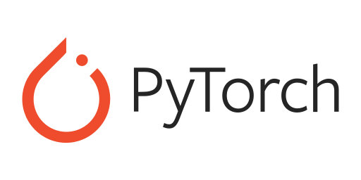
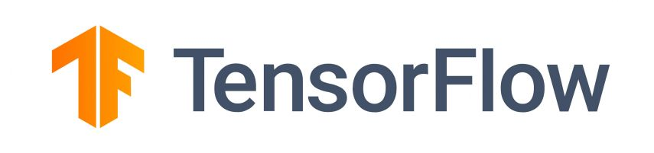
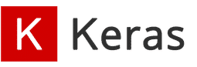
AI Drives Exploration Across Domains (2/4)
Several examples exist:
Telescope image classification to identify black holes
Medical models that detect tumors and cancerous cells from X-rays and MRIs
Large-language models that can act as chatbots for responding to questions
Deep Learning (DL) uses neural networks to model complex relationships in data

Slide 106






AI Drives Exploration Across Domains (3/4)
Grading homework
Large Language Models (LLMs) can respond to a broad range of prompts using natural language
Doing homework
Pair Programming
Analyzing small datasets
Summarizing documents
Image generation
ChatGPT
Llama
Firefly

Slide 107
AI Drives Exploration Across Domains (4/4)
Scientific systems are beginning to use AI to automatically execute complex applications and workflows in response to prompts
Will there be a hurricane in Florida in the next 3 months?
LLM
Run the Job
Generate Weather Parameters
Detect if Hurricane based on job output
Locate Weather Simulation in Storage
Submit job to cluster

Slide 108
AI Apps have Diverse I/O Requirements
Weather Sensors
Summarize techniques to predict cloud formations
Simulate cloud formations for the next 7 days
Storage
Inference LLM
Inference LLM
Derive Weather Params
(e.g., temp / sec)
Weather Infer
Storage
Simulations (e.g., PyFlextrkr) are used to predict cloud formations based on live weather data
Weather Train
DBSCAN Clustering
Cloud formations have been stored in /weather
Requires custom data transformations and good small read access latency
Requires low latency and large memory.
Requires high read and write bandwidth

Slide 109
AI Apps have Diverse I/O Requirements
Weather Sensors
Summarize techniques to predict cloud formations
Simulate cloud formations for the next 7 days
Storage
Inference LLM
Inference LLM
Derive Weather Params
(e.g., temp / sec)
Weather Infer
Storage
Simulations (e.g., PyFlextrkr) are used to predict cloud formations based on live weather data
Weather Train
DBSCAN Clustering
Cloud formations have been stored in /weather
Requires custom data transformations and good small read access latency
Requires low latency and large memory.
Requires high read and write bandwidth

Slide 110
AI Apps have Diverse I/O Requirements
Weather Sensors
Summarize techniques to predict cloud formations
Simulate cloud formations for the next 7 days
Storage
Inference LLM
Inference LLM
Derive Weather Params
(e.g., temp / sec)
Weather Infer
Storage
Simulations (e.g., PyFlextrkr) are used to predict cloud formations based on live weather data
Weather Train
DBSCAN Clustering
Cloud formations have been stored in /weather
Requires custom data transformations and good small read access latency
Requires low latency and large memory.
Requires high read and write bandwidth

Slide 111
AI Apps have Diverse I/O Requirements
Weather Sensors
Summarize techniques to predict cloud formations
Simulate cloud formations for the next 7 days
Storage
Inference LLM
Inference LLM
Derive Weather Params
(e.g., temp / sec)
Weather Infer
Storage
Simulations (e.g., PyFlextrkr) are used to predict cloud formations based on live weather data
Weather Train
DBSCAN Clustering
Cloud formations have been stored in /weather
Requires custom data transformations and good small read access latency
Requires low latency and large memory.
Requires high read and write bandwidth

Slide 112
Workload Diversity Causes Contention
Custom data ops contend with app threads
Large I/O ops can stall small I/O ops
I/O ops can stall each other across apps
Fig 3
Fig 4
Fig 1
Fig 2
1MB
(1ms)
4KB
(15us)
AI
Op
AI
4KB
(15us)
1MB
(1ms)
Weather Infer
(512MB/sec)
Weather Infer
(512MB/sec)
CPU
CPU
Storage
Storage (1GB/sec)
The AI has more cores in Fig1 than Fig2 because no ops
Fig3: 4KB runs in 15us
Fig4: 4KB runs in 1ms
68x slowdown
Total bandwidth gets split across apps
Multi-tenant environments (the norm) exaggerate resource contention
Multi-Tenant: multiple apps (tenants) run simultaneously
E.g., containers in Cloud, workflows in HPC

Slide 113
LabStor

Slide 114

The Limitations of Kernel-Level I/O Stacks
Limited
Extensibility
Tight
Coupling
Limited
Configurability
Cumbersome
Deployments

Slide 115



Limited Extensibility
Applications
HDF5, NetCDF, pNetCDF, etc.
MPI-IO
Cannot expose APIs alternative to POSIX
POSIX
read()
write()
VFS
EXT4
XFS
F2FS
I/O stacks only support the filesystems layer!
Direct I/O
Page Cache
Cannot improve other layers of the I/O stack
Block I/O Layer
I/O Scheduling
Limits performance and feature richness!
Device Drivers

Slide 116
Tight Coupling
I/O stacks are tightly coupled with a large set of features
POSIX
read()
write()
VFS
F2FS
split
Access Ctrl
compress
encrypt
They cannot be reused by other I/O stacks
block alloc
compact
I/O stacks do not promote the single responsibility principle!
Direct I/O
Page Cache
Block I/O Layer
I/O Scheduling
Duplicated implementation and debugging effort!
Device Drivers

Slide 117
Limited Configurability
POSIX
Some policies are non-negotiable
read()
write()
VFS
EXT4
Access Ctrl
split
block alloc
I/O stacks are shipped with a fixed set of features!
Direct I/O
Page Cache
Some policies are not workload or hardware-optimized
Block I/O Layer
I/O Scheduling
Device Drivers
Performance degradation!

Slide 118
Cumbersome Deployments
Upgrades require reboots and potentially kernel recompilation
I/O stacks suffer from cumbersome deployment pipelines!
Lowers adoption rates!

Slide 119
What the Runtime Gives
Apps use LabMod connectors to send tasks to the Runtime
The runtime spawns workers to execute LabStack work
Protocols for upgrading code and recovering from crash
Crash recovery: what happens if a LabMod was buggy and crashed the Runtime?
  Data structures in shared memory, and can be recovered after a crash
Upgrade protocols: how to update LabMods after deployment?
  The loosely-coupled nature of LabStacks makes this easy
  Request queues are paused, and all pending operations will be completed
  The upgrades are then processed

Slide 120
Challenges to Solve these Questions
I/O stacks must switch to a modular design
New reactive algorithms must be created to automatically match I/O and computations to hardware
New scheduling policies for understanding diverse, multi-tenant AI and hardware characteristics
Must find suitable abstraction to encompass variety
Must respect the need for specific workload and hardware optimizations
Each storage and processor have special characteristics that require expertise to manage.
For each new device, this matching becomes more complex
Apps are diverse and conflict with each other differently
An exponentially-complex problem

Slide 121
The LabStor System
We aim to reinvision the way that I/O stacks are developed and deployed to improve the customizability and code velocity of future I/O stacks

Slide 122

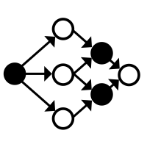

The LabStor System
I/O stacks must switch to a modular design
LabMod
LabStack
LabStor Runtime
An upgradeable code object representing data and ops that can happen to the data
(e.g., FS, compress)
Combination of compatible LabMods into a specialized I/O stack
The main execution engine and provides protocols for upgrading code

Slide 123
The LabStor Platform
I/O Sched
Page Cache
KVS
FS
FS Transform
LabMod
Promote
Extensibility
Single
Responsibility
An upgradeable code object representing data and operations that can happen to the data
Provide a wide (and extensible) menu of types for every layer of the stack
Provide separate types for filesystems and their features
Notes:
LabMods are the core building blocks of LabStor.
With LabMods, we aim to move away from the monolithic design of the kernel and enable development of all layers of the I/O stack.
In LabStor, a LabMod can represent any functionality. They can be built for I/O schedulers, permissions, device drivers, filesystems, etc. LabStor inherently provides LabMods which expose the kernel’s device drivers directly to userspace
LabMods can be incrementally upgraded, swapped, and stacked.

Slide 124
The LabStor Platform
LabStack
Enable
Configurability
The combination of compatible LabMods into an optimized storage stack
Provide a human-readable schema file format to define LabStacks
Notes:
LabStacks are the composition of LabMOds into an I/O system.
This allows users to create lean, custom I/O stacks for their use case.
Users can plug and play different combinations of modules to optimize their stack.

Slide 125
The LabStor Platform
LabStor Runtime
Optimize
Deployment
Main warehouse and execution engine of LabStor
Protocols to upgrade I/O stacks
Protocols to recover from a crash
Notes:
Lastly, the LabStor runtime is the primary execution engine and warehouse for LabStacks and LabMods.
The LabStor Runtime provides APIs to query both LabMods and LabStacks, making it possible to deploy multiple I/O stacks at the same time.
Secondly, the LabStor Runtime provides security by allowing LabStacks to execute with different levels of privilege.

Slide 126


Towards Modularity: What LabMods Are
An independent, self-contained code object implementing a single-purpose functionality
Contains the event handlers and callbacks necessary to build upgradeable I/O features
General enough to phrase a variety of I/O requirements
Incrementally
Upgradeable
Stackable

Slide 127



LabMod Components
Client
1. Type
2. Connector
1. write("/home/hi.txt", 1MB, data)
The set of APIs the LabMod implements
Builds LabTasks: message holding the parameters to the operation
FILE I/O LabMod
Connector
State
3. Allocate disk space
Space
Allocator
2. File I/O LabTask
Operation
4. Write to disk Locations
3. Operation
4. State
Disk
Functionality of the LabMod
(executes LabTasks)
Internal data required for the operation

Slide 128
Our Prototype LabMods
Features
Auth
Compress
Metadata Management
LabFS
LabKVS
Caching
LRU
I/O Scheduler
No-Op
Blk Sw
Drivers
Posix
Kernel
SPDK

Slide 129
Examples: I/O Specialization (1)
fs::/a
Compress
EXT4
LRU
Driver
Typically, a filesystem will have one rigid set of features
E.g., compression on every I/O access

Slide 130
Examples: I/O Specialization (2)
No
Compress
LabFS
LRU
Driver
fs::/a
Low-Latency?
Yes
LabFS
Driver
Can provide different paths which have different optimizations
High-bandwidth requests get compression + caching
Low-latency requests get stored ASAP

Slide 131
Examples: Interface Convergence & Diversity
kvs::/a
LabKVS
LRU
NoOp
Driver
fs::/a
LabFS
log::/a
Log
Provide alternative APIs and data representation to POSIX
Expose different APIs over the same content
Data stored as objects, but accessed using either log or filesystem APIs

Slide 132
Examples: Tunable Access Control (1)
fs::/a
ACL
LabFS
LRU
NoOp
KDriver
fs::/a
LabFS
LRU
NoOp
KDriver
Authentication is typically required on every request in Linux
Can completely disable authentication by removing that LabMod
Useful when hardware is dedicated to a user

Slide 133
Examples: Tunable Access Control (2)
Island A
LabFS
LRU
NoOp
KDriver
fs::/a
Users A
Paths A
Island B
fs::/b
Users B
Paths B
Alternative approaches to authentication can also be created
fs::/a and fs::/b give users access to different “data islands”

Slide 134
What the Runtime Gives
Apps use LabMod connectors to send ops to the Runtime
The runtime spawns workers to execute LabStacks
  User or kernel space
  Depends on their access needs
Protocols for upgrading code and recovering from crash
  Simplified due to the loosely coupled nature of LabMods
  It takes only 15ms to upgrade a LabMod, whereas a system reboot can be minutes

Slide 135
Executing LabStacks (1)
Client initially registers with the Runtime
Create shared-memory queues between client & runtime
Client loads the connector of “Generic LabMod” from the Namespace
Call the connector to place an I/O request in the queue

Slide 136
Enable
Configurability
The LabStack
A user-defined combination of compatible LabMods into a single I/O system
Pick &
Choose
Dynamic
Modification
Choose only the LabMods required by the I/O stack
Dynamically modify
to adapt to changing I/O requirements

Slide 137
Evaluations

Slide 138
Evaluation Objectives
Modularity
Customization
The choice of modules have major performance impacts
I/O stacks should be more customized to the workload and environment

Slide 139
Experimental Setup: LabStacks
Lab-All
Lab-Min
Lab-D
Client
Client
Client
Inter-Process Comm (IPC)
IPC
LabKVS
Permissions
LRU
LabKVS
LabKVS
NoOp
LRU
LRU
Drivers
NoOp
NoOp
Drivers
Drivers

Slide 140
The Importance of Modularity and Customization
Demonstrate the impact of modular single-node I/O stacks on a distributed system -- Labios
We vary the storage backend between kernel-level filesystems and LabKVS
We run a workload where Labios generates 8KB I/O to NVMe storage

Slide 141
The Importance of Modularity and Customization
Lab-D is 18% faster than Lab-All by removing permissions checks and IPC
  Choice of modules has performance impacts
LabKVS up to 60% faster than the filesystems. KVS is more scalable than FS due to less metadata and software overhead
  I/O stack features should be customized to the workload

Slide 142
How to deploy LabStacks?

Slide 143
Deployment
LabStacks are mounted in the LabStack Namespace using a utility script (mount.labstack)
After mounting, there are three ways of accessing it:
  Native API (GetConnector)
  API Interception (Generic LabMods)
  System calls (VFS)

Slide 144
Generic LabMods & Unified Namespace
Intercept
Route
Reuse
Intercept I/O for a particular API
(e.g., POSIX)
Many implementations of the same API at the same time
Manages state common between I/O systems of a particular type
LabStack NS
Application
open()
write()
open(“/ext4/hi.txt”)
descriptor
Key
LabStack
GenericPosix
/ext4
EXT4
File Descriptor Table
open()
write()
/f2fs
F2FS
open(“/ext4/hi.txt”)
/btrfs
BTRFS
EXT4
F2FS
BTRFS
Notes:
To support a wide diversity of I/O interfaces outside of POSIX, LabStor provides the concept of Generic LabMods.

Slide 145
Generic LabMods & Unified Namespace
Intercept
Route
Reuse
Intercept I/O for a particular API
(e.g., POSIX)
Many implementations of the same API at the same time
Manages state common between I/O systems of a particular type
LabStack NS
Application
open()
write()
open(“/ext4/hi.txt”)
descriptor
Key
LabStack
GenericPosix
/ext4
EXT4
File Descriptor Table
open()
write()
/f2fs
F2FS
open(“/ext4/hi.txt”)
/btrfs
BTRFS
EXT4
F2FS
BTRFS
Notes:
GenericLabMods intercept all I/O requests for a particular API, such as POSIX or key-value store.
In the example, this includes the open() and write() functions.

Slide 146
Generic LabMods & Unified Namespace
Intercept
Route
Reuse
Intercept I/O for a particular API
(e.g., POSIX)
Many implementations of the same API at the same time
Manages state common between I/O systems of a particular type
LabStack NS
Application
open()
write()
open(“/ext4/hi.txt”)
descriptor
Key
LabStack
GenericPosix
/ext4
EXT4
File Descriptor Table
open()
write()
/f2fs
F2FS
open(“/ext4/hi.txt”)
/btrfs
BTRFS
EXT4
F2FS
BTRFS
Notes:
They then route requests to the proper filesystem implementation, when there are multiple implementations of the API running at the same time.
In the example below, the open command writes the file “hi.txt” to the EXT4 filesystem.

Slide 147
Generic LabMods & Unified Namespace
Intercept
Route
Reuse
Intercept I/O for a particular API
(e.g., POSIX)
Many implementations of the same API at the same time
Manages state common between I/O systems of a particular type
LabStack NS
Application
open()
write()
open(“/ext4/hi.txt”)
descriptor
Key
LabStack
GenericPosix
/ext4
EXT4
File Descriptor Table
open()
write()
/f2fs
F2FS
open(“/ext4/hi.txt”)
/btrfs
BTRFS
EXT4
F2FS
BTRFS
Notes:
Lastly, GenericLabMods manages state common between I/O systems of a particular type.
In the example below, this state would be a file descriptor table. If we allowed the file descriptor table to be per-filesystem, then there would be the potential to have conflicting file descriptors.

Slide 148
Other deployment considerations
Crash recovery: what happens if a LabMod was buggy and crashed the Runtime?
  Data structures in shared memory, and can be recovered after a crash
Upgrade protocols: how to update LabMods after deployment?
  Request queues are paused, and all pending operations will be completed
  The upgrades are then processed

Slide 149
What is the performance benefit of having a configurable I/O stack?

Slide 150
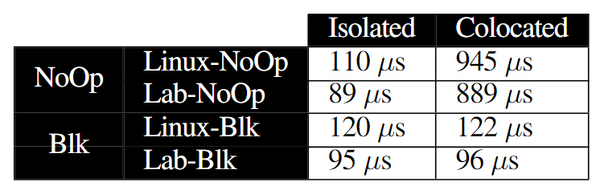
Developing and Customizing I/O Policies
LabStor’s NoOp and Blk-Switch are 20% faster than their in-kernel counterpart
LabStor bypasses significant in-kernel overheads

Slide 151
Developing and Customizing I/O Policies
Two ioscheds
  No-Op
  Blk-Switch
Two workloads:
  Latency: synchronous 4K requests
  Bandwidth: synchronous 16MB requests
Compare when the workloads are isolated and colocated
Latency
(4KB)
Latency
(4KB)
Bandwidth
(16MB)
Bandwidth
(16MB)
CPU
CPU
CPU
CPU
vs
Bandwidth
(16MB)
Bandwidth
(16MB)
Latency
(4KB)
Latency
(4KB)
CPU
CPU
Notes:
In this evaluation, we aim to demonstrate the correctness of LabStor’s design and the importance of customizing policies to the specific workload.
Here we compare the development of two I/O schedulers: no-op and blk-switch.
No-op simply hashes I/O requests to NVMe hardware queues, whereas blk-switch intelligently divides hardware queues into latency and throughput queues.
We run a workload which performs

Slide 152
Developing and Customizing I/O Policies
No-Op is 8% faster than blk-switch when there is no colocation
Blk-sw has overhead due to additional logic

Slide 153
Developing and Customizing I/O Policies
Blk-switch is 10x faster than No-Op when there is colocation
Routes latency-sensitive requests to separate queues, reducing starvation

Slide 154
Developing and Customizing I/O Policies
Both policies have pros and cons in different circumstances

Slide 155
What is the benefit of enabling more than just POSIX filesystems to be developed?

Slide 156
How does increased modularity improve real-world programs?

Slide 157
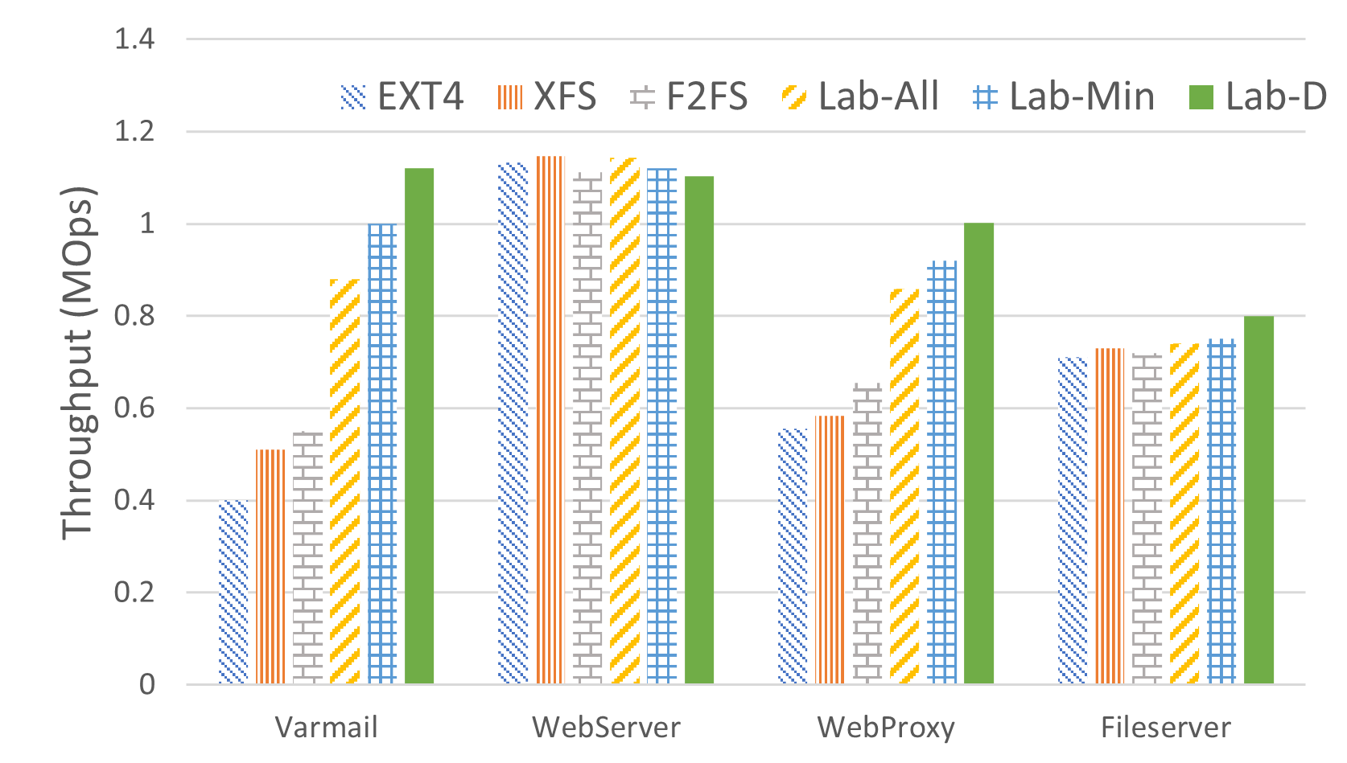
Filebench
We run a full real-workload over various LabStacks
We find that different LabStor configurations yield different performance
  Except webserver, which performs large-sequential I/O
Can save up to 40% on performance by choosing only the required labmods

Slide 158


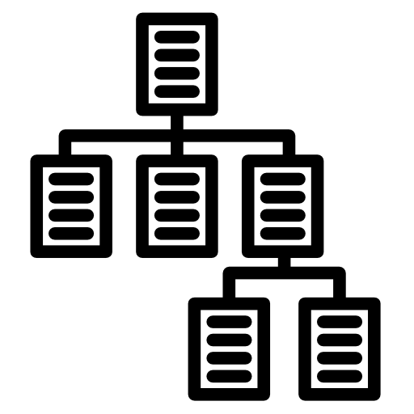
Diverse Storage Driver Layer
Various ways to interact with hardware
Tradeoffs between hardware-generality and performance
POSIX LabMod
I/O Uring LabMod
Kernel Driver LabMod
SPDK LabMod
Syscall
VFS
VFS
VFS
VFS
EXT4
XFS
EXT4
XFS
EXT4
XFS
EXT4
XFS
Cache
Direct I/O
Cache
Direct I/O
Cache
Direct I/O
Cache
Direct I/O
Block I/O Layer
Block I/O Layer
Block I/O Layer
Block I/O Layer
I/O Scheduling
I/O Scheduling
I/O Scheduling
I/O Scheduling
Device Drivers
Device Drivers
Device Drivers
Device Drivers
Storage Devices
Storage Devices
Storage Devices
Storage Devices
Notes:
In order to provide the same wide hardware support as the kernel, LabStor provides a variety of Driver LabMods which expose device drivers.
POSIX, I/O Uring, and Kernel Driver LabMods work on any storage device type.
We also provide specialized storage drivers, such as SPDK, which provide more optimized paths to the hardware.

Slide 159

Conclusions
LabStor: a system for developing high-performance, customized I/O stacks
Modular
Composable
Performant
Provide expressive, customizable and high-velocity I/O stacks
Provide the ability to upgrade and manage I/O stacks in an easy and efficient manner
Up to 60% gains under various workloads and devices

Slide 160
Chimaera

Slide 161
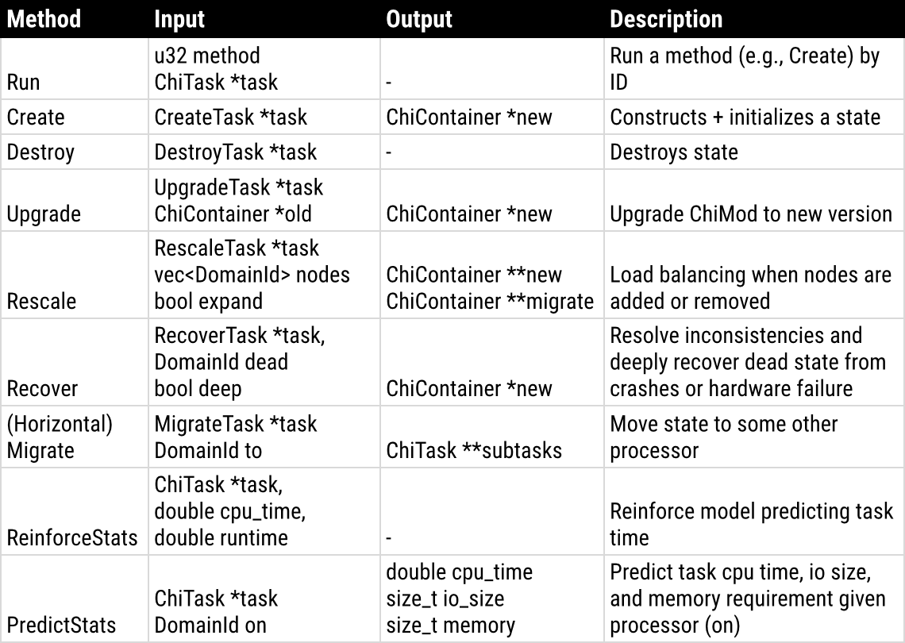
The Basic Operations of ChiMods
ChiMods must implement a basic set of APIs
How to recover from a crash
How to process upgrades
Methods to learn ChiMod performance on heterogeneous hardware
  E.g., I/O may have linear model while metadata is a constant

Slide 162
Enhancing the Modular Design
ChiMod: a code object representing state and ops that can be performed in the context of that state
  E.g., a filesystem exposes read/write (ops) and stores data + metadata (state)
ChiMods can have multiple implementations
  E.g., a transparent fraud detection algorithm may have implementations for SmartNIC, CPU, and GPU
This allows ChiMod work (known as ChiTasks) to be migrated across heterogeneous processors
Several use cases:
  If one processor is more energy-efficient and doesn't affect overall performance, we can migrate there
  If one processor is overutilized, we can migrate to a different one
  If one processor dies, we can recover at a different one

Slide 163
Orchestrating ChiContainers
Runtime dynamically monitors the computational and I/O behavior of ChiContainers
This trains performance models defined by ChiMods
  E.g., a persistent key-value store ChiMod may implement a linear model based on I/O size
Used for algorithms to migrate ChiLanes and ChiContainers in the ChiOrchestrator
  Vertical migration
  Horizontal migration

Slide 164
Composing Complex I/O Stacks
ChiPools can be stacked together to form complex, heterogeneous I/O stacks
ChiContainers and ChiLanes are automatically scheduled across heterogeneous processing resources
AI apps only need to remember ChiContainer names, not their physical location in the system
  Names are resolved dynamically to physical node addresses by Chimaera
ChiContainers implement policies to automate data movement on storage resources
Pool 1: Compression
Pool 2: Encrypt
Pool 3: Key-Value Store
Pool 4: Device Drivers

Slide 165
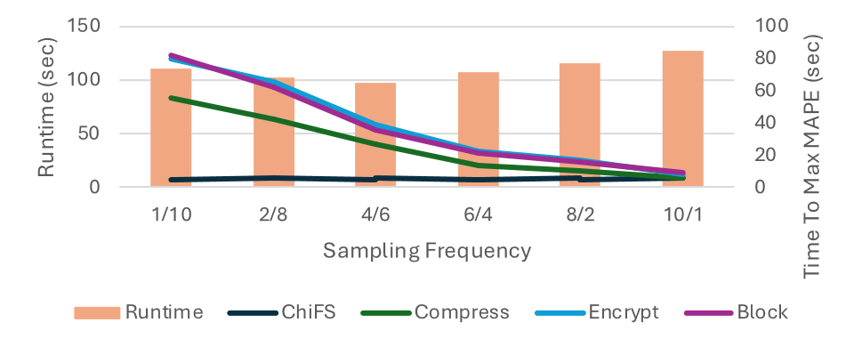
Dynamically Learning Performance
1/10 means sample for 1sec and then wait 10sec.
Impact of sampling frequency on the time to max accuracy (mean absolute percentage error)
  Max MAPE: on average, performance model within 15% of true value
Vertical migration is enabled, allowing migration across CPU, SmartNIC, and CSD
Took 4 example ChiMods and varied sampling rate

Slide 166
Dynamically Learning Performance
1/10 means sample for 1sec and then wait 10sec.
4/6 sampling frequency get to max MAPE 2x faster than 1/10
4/6 sampling frequency results in better performance than 1/10 due to improved vertical scheduling decisions
4/6 is faster than 10/1 since it makes good decisions for most of the program and samples about 10x less than 10/1

Slide 167
Dynamically Learning Performance
1/10 means sample for 1sec and then wait 10sec.
4/6 sampling frequency get to max MAPE 2x faster than 1/10
4/6 sampling frequency results in better performance than 1/10 due to improved vertical scheduling decisions
4/6 is faster than 10/1 since it makes good decisions for most of the program and samples about 10x less than 10/1

Slide 168
MegaMmap

Slide 169
Typical Out-Of-Core Programming Approach
Have separate, synchronous phases for compute and I/O
Incur memory wall in the compute phases
Incur I/O bottleneck in the I/O phases
When combined, they make for a very slow program!
(e.g., many scientific simulations)
(e.g., Apache Spark)
Compute
I/O
Map
Shuffle
Reduce
Memory Wall
I/O Bottleneck
Memory Wall
I/O Bottleneck
Memory Wall

Slide 170
Limitations of Existing DSMs
Agnostic to application behavior
  Significant performance overhead to maintain coherence
  Flurries of small messages to handle caching and replication
  E.g., locking a page to ensure coherence
DSMs are Cloud-focused
  Provide replication to handle frequent hardware failures, incurring overhead
  Assume multiple tenants access the same data, which is uncommon in coordinated (e.g., MPI) AI workloads
No tiering
  Most DSMs focus only on DRAM, but ignore storage tiers
  Limited capacity

Slide 171
Tiered DSM Challenges
Applications must be able to propagate access pattern intentions
  Can reduce the need for fine-grained synchronizations
  Can improve tiered data organization decisions
Memory coherence policies must be optimized to address the characteristics of coordinated AI workloads
  Coordinated workloads do not always need aggressive cache evictions
  E.g, read-only analysis workflows never need to invalidate caches
New data placement + prefetching policies must be developed to address memory behavior, rather than storage

Slide 172
Masking I/O Stalls
How to get data from storage into memory without incurring an I/O stall
Runs asynchronously and is called periodically
Applications inform the prefetcher of its access pattern intention using transactions
With advance knowledge of access pattern and storage performance, we can make good decisions of what data to prefetch

Slide 173
Efficient Memory Coherence
R/W Local avoids cache coherence overheads completely
  All data is accessed locally
R Global avoids cache coherence overheads completely
  No data is modified
R/W/A Global minimizes the overhead using properties of queueing
  Modifications are sent asynchronously and sequenced by queues

Slide 174
Evaluation Objectives
Memory coherence of DSM are not a scalability bottleneck compared to leading HPC+Cloud communication solutions, such as MPI and Spark.
Tiering memory can increase the resolution of scientific datasets by eliminating memory constraints, allowing more detail in the final simulation data.
Intelligently tiering memory can bring performance benefits to out-of-core algorithms.
DRAM consumption can be lowered by offloading memory to tiered storage.

Slide 175
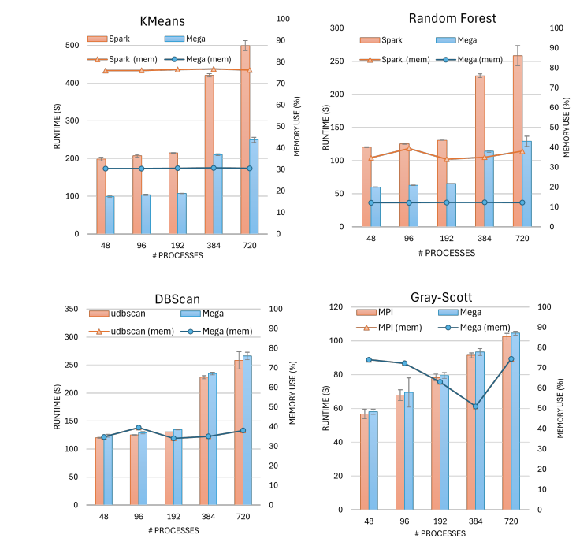
DSMs can perform well
MegaMmap scales just as well as MPI
MegaMmap scales and performs 2x better than spark

Slide 176
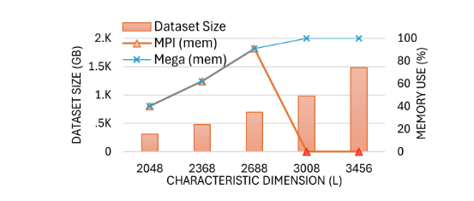
We can do more science!
MegaMmap allows for twice the data to be processed without crashing

Slide 177
Future Work 2: IoWarp
Our recent NSF grant will build a plaform for scientific computing environments that use LLMs to interface with storage systems, job schedulers and datasets
Chimaera is being used as the foundation to leverage heterogeneous storage and processing resources
We plan to add new data operators to improve data quality
  Chimaera calculates average temp for weather sim and adds to metadata
  Q: "Describe the data for the most recent weather simulation output"
  R: "This is an HDF5 file where the average temperature is 85f"
We plan to add new data movement algos for deep learning
We intend to improve our evaluation to include deep learning

